Slide 1
Controlled Parking for Self-Driving Cars

Slide 2


Outline
Introduction
Problem of the Research
Related works
Graph Generation
Parking lot structures
z

Slide 3

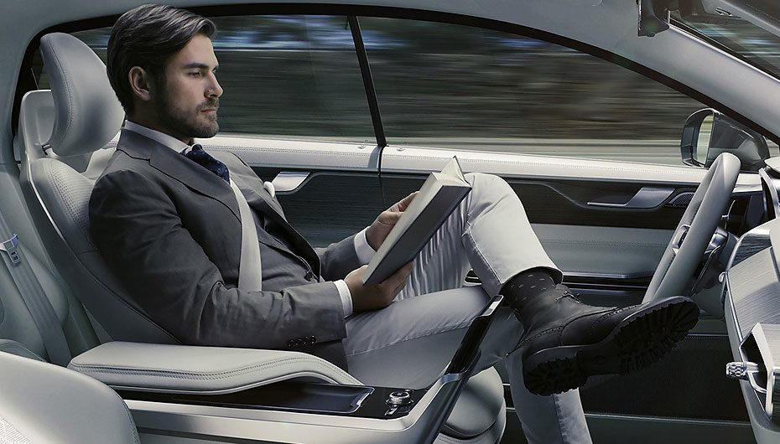
Introduction
z
An autonomous car (AC) is a vehicle that is adept at sensing its surroundings and navigating without human involvement. These self-driving cars have to blend into the current transport system without disturbing it, which means that these should be able to perform all the tasks which a normal car could do when driven by a human being.

Slide 4
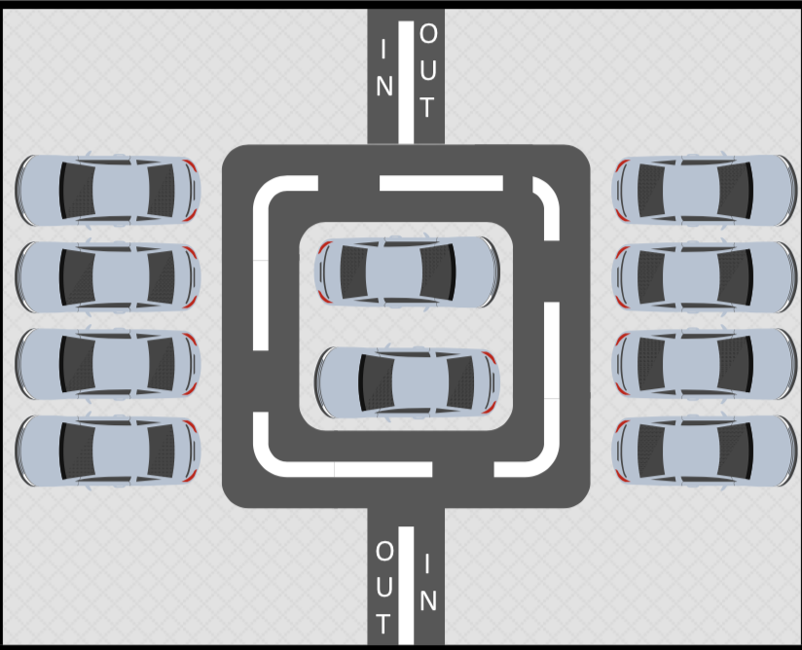
Problem of the Research
z
How do you know which parking slot is the best for you to park, based on the position of the car?
Is there a way by which every AC can be parked to the closest available parking slot? How would we handle different kinds of parking lot structures?

Slide 5
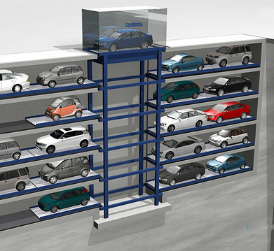
Related works
z
Parking an AC in a parking lot is similar in many aspects to the automated parking systems (APS). APS is a mechanical system designed to minimize the area and /or volume required for parking cars.

Slide 6
Related works
A Secure and Intelligent Parking System” based on secured wireless network and sensors communication through which they assure that the parking reservation is safe and privacy is preserved.
proposes a model to predict the parking lot occupancy based on the information shared among the vehicles present in the parking lot they also use the age of the information to predict the current situation as well.

Slide 7
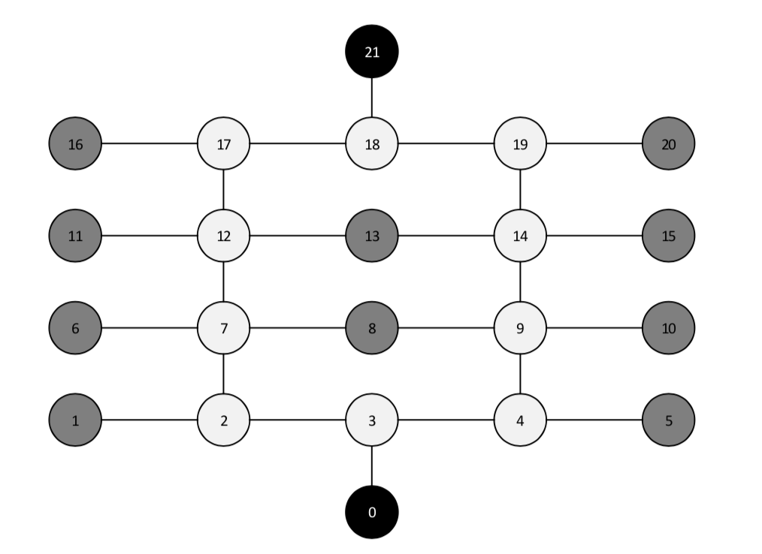
Graph Generation
z
P-node can only be linked to one or more T-node.
T-node can be linked to any node.
E-node can only be linked to a T-node.

Slide 8
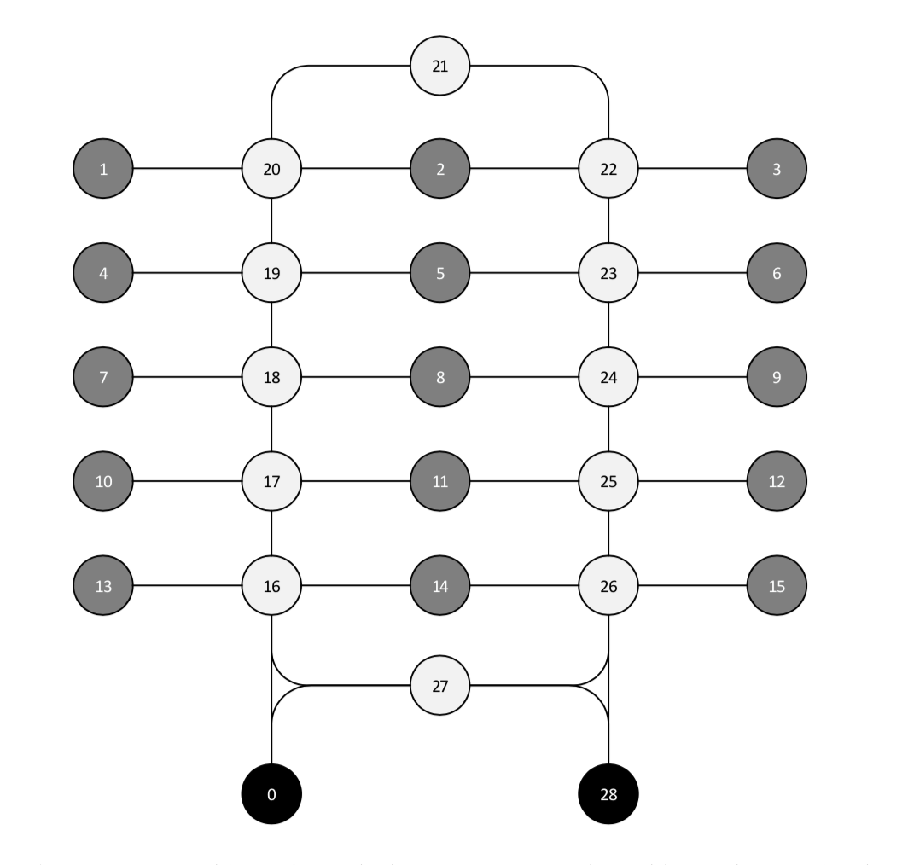
Graph Generation(2)
z
The basic purpose of this algorithm is to tell the car about the nearest parking slot available to it from the entrance i.e. to act as a “Parking Control Service” (PCS).

Slide 9
Parking lot Structure
Normal parking lot structure
Blocked parking lot structure

Slide 10
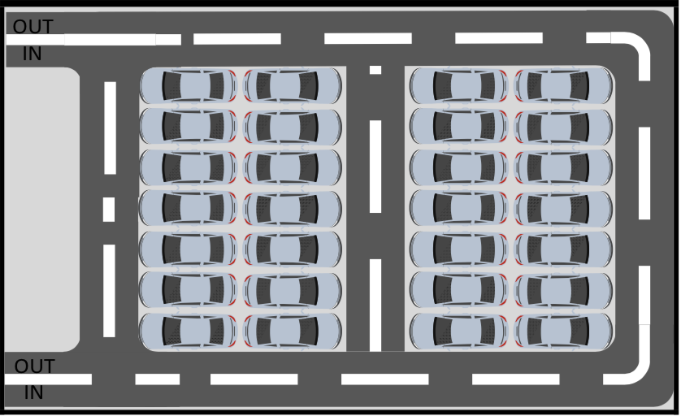
Normal parking lot structure
z
z

Slide 11
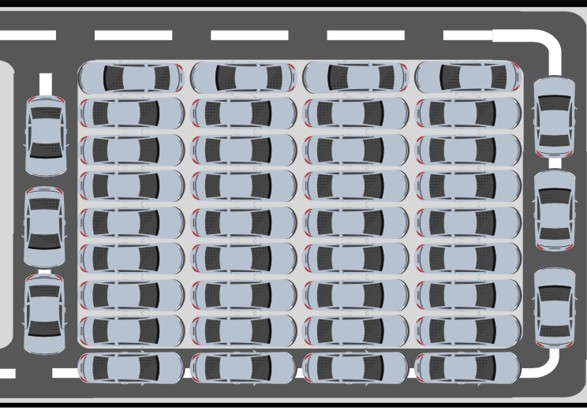
Blocked parking lot structure
z
z

Slide 12
z
z

Slide 13
Discussions
Handling and navigating an AC in different environment and surroundings is a relatively new so there is a lot of room to improve and optimize the way things were done before.
These cars can communicate with each other make decision on their own so we have lot more information to process and make more intelligent decisions based on that information.
As a part of the future work, instead of doing experiments with simulated cars' in & out data, we will collect the real in- and-out data from real parking lots to use it on real parking lot structures

Slide 14
ACKNOWLEDGMENT
This research was supported by Basic Science Research Program through the National Research Foundation of Korea (NRF) funded by the Ministry of Science, ICT & Future Planning (NRF-2013R1A1A1076060).

